Slide 1
useEffect Demo

Slide 2
The Effect Hook, just like the name implies, carries out an effect each time there is a state change.
By default, it runs after the first render and every time the state is updated.

Slide 3
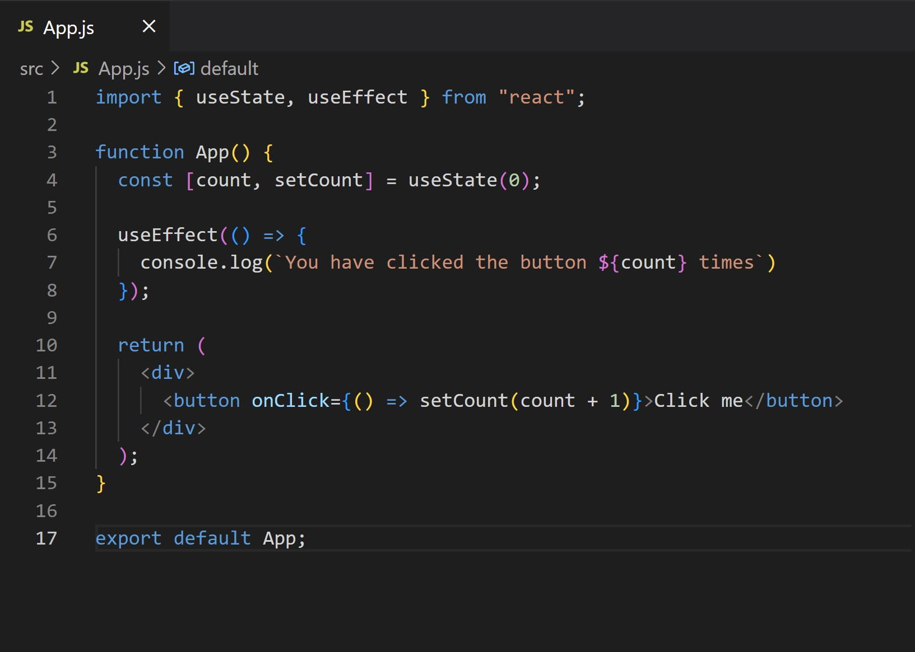
Create New React app. Modify App.js

Slide 4
In the example above, we create a state variable Count with an initial value of zero.
A button in the DOM will increase the value of this variable by one every time it is clicked.
The useEffect hook will run every time the count variable changes and then log out some information to the console.

Slide 5
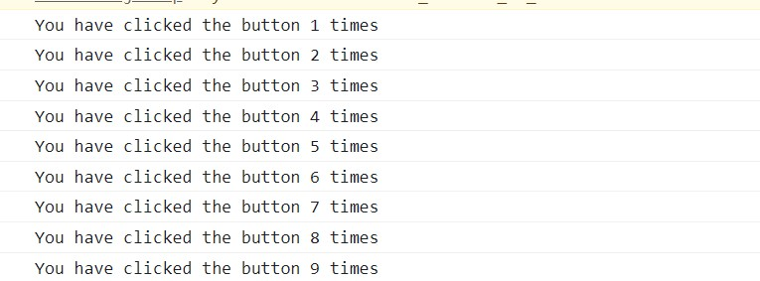
Run application and check output.

Slide 6
Note that you can use the useEffect hook to achieve various effects like fetching data from an external API (which you will see in another section of this article), changing the DOM in your component, and so on.

Slide 7
useEffect Dependencies
But what happens if you want your effect to run only after the first render, or if you have multiple states and only want an effect attached to one of the states.
We can do this by using a dependency array which is passed in as a second argument in the useEffect hook.

Slide 8
How to run effect only once
For the first example, we pass in an array that allows the useEffect hook to run only once.

Slide 9
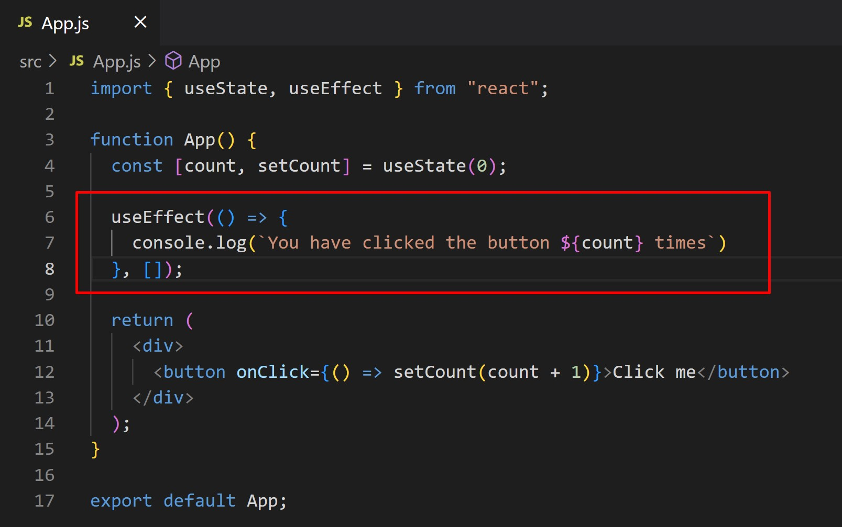
The code is the same as previous section, except that the useEffect hook accepts an empty array[] as second argument. When we leave the array empty, the effect will only run once irrespective of the changes to the state it is attached.

Slide 11
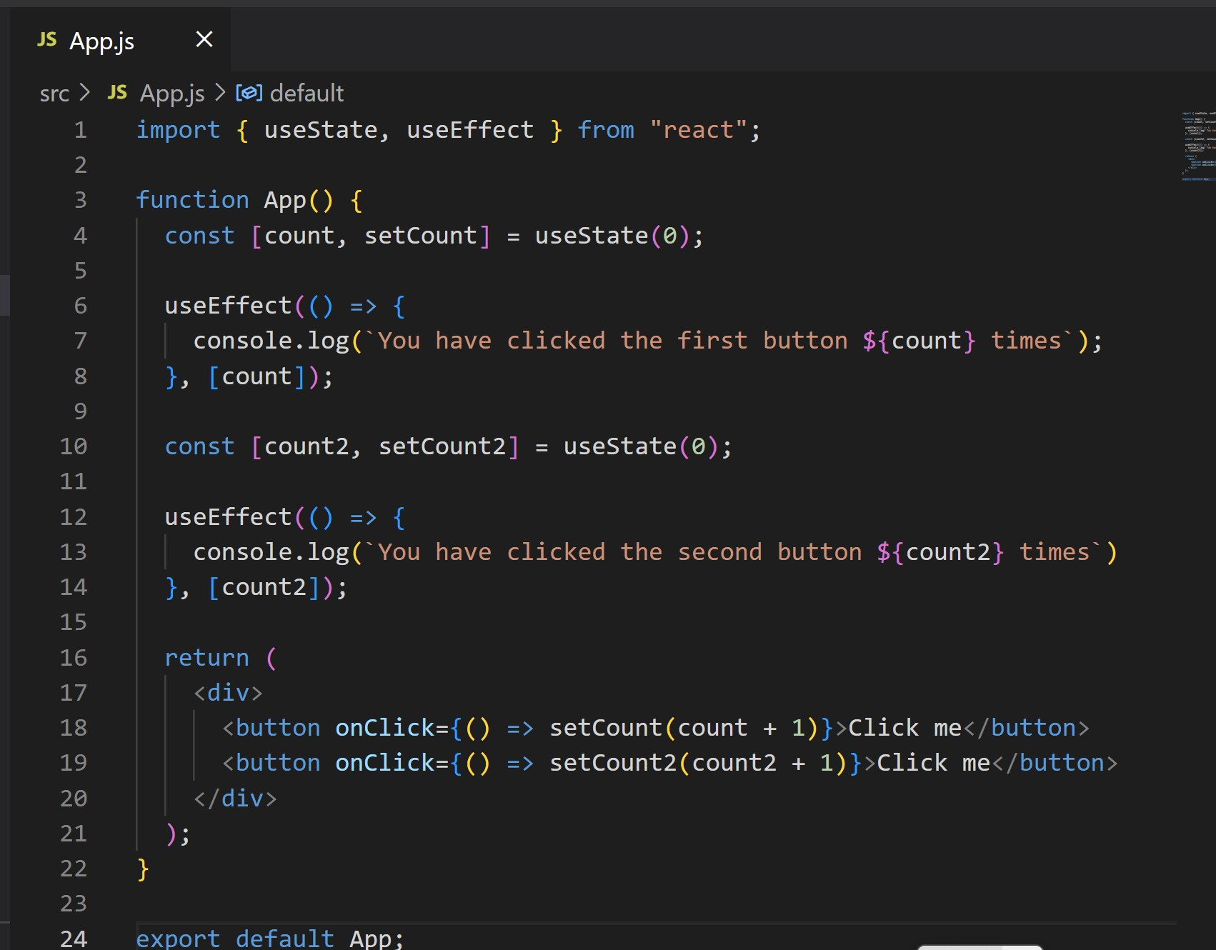
How to attach an effect to a particular state

Slide 12
In the above example, we created two states and two useEffect hooks. Each state has an after effect attached to it by passing the name of the state [count] and [count2] to the corresponding useEffect array dependency.
So when the state of count changes, the useEffect hook responsible for watching these changes will carry out any after effect assigned to it. Same applies to coutn2.

Slide 13
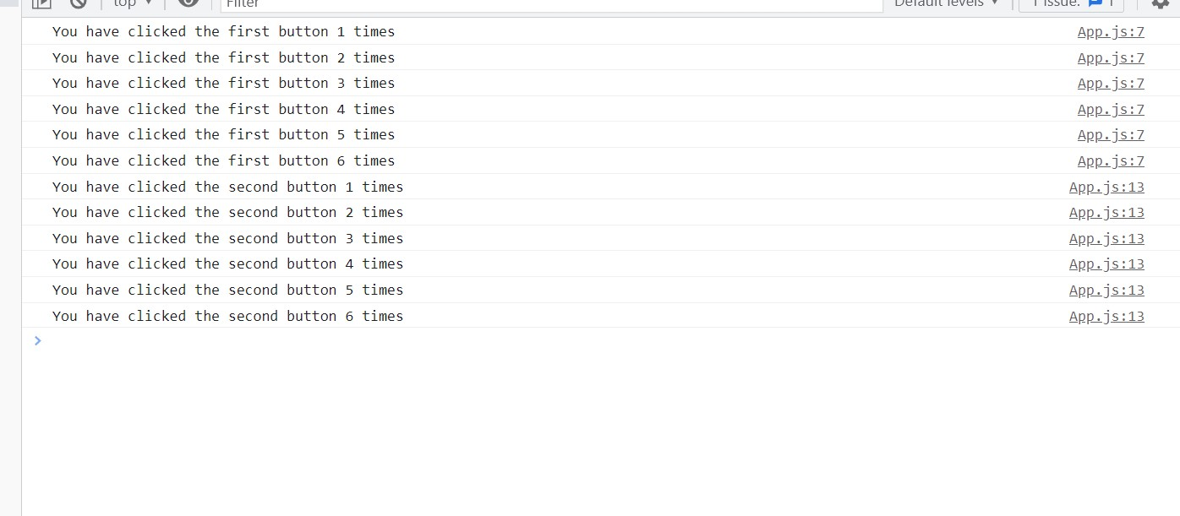
Run the application and check output.

Slide 14
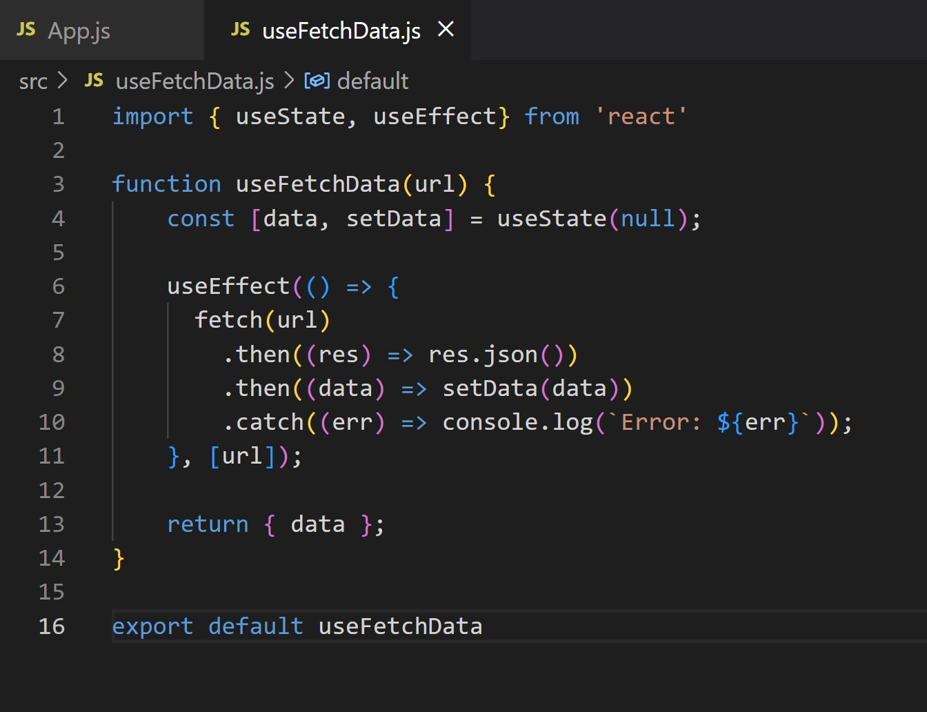
Now, let us create our custom hook. Create a new file called useFetchData.js and add the code as shown here.

Slide 15
We create a state to hold the data that will be returned – the initial state will be null: cost [data,setData] = useState(null).
The data returned will update the value of the data variable using the setData() function.
We create an effect that runs on first render and every time the url parameter changes.
We return the data variable: return { data }

Slide 16
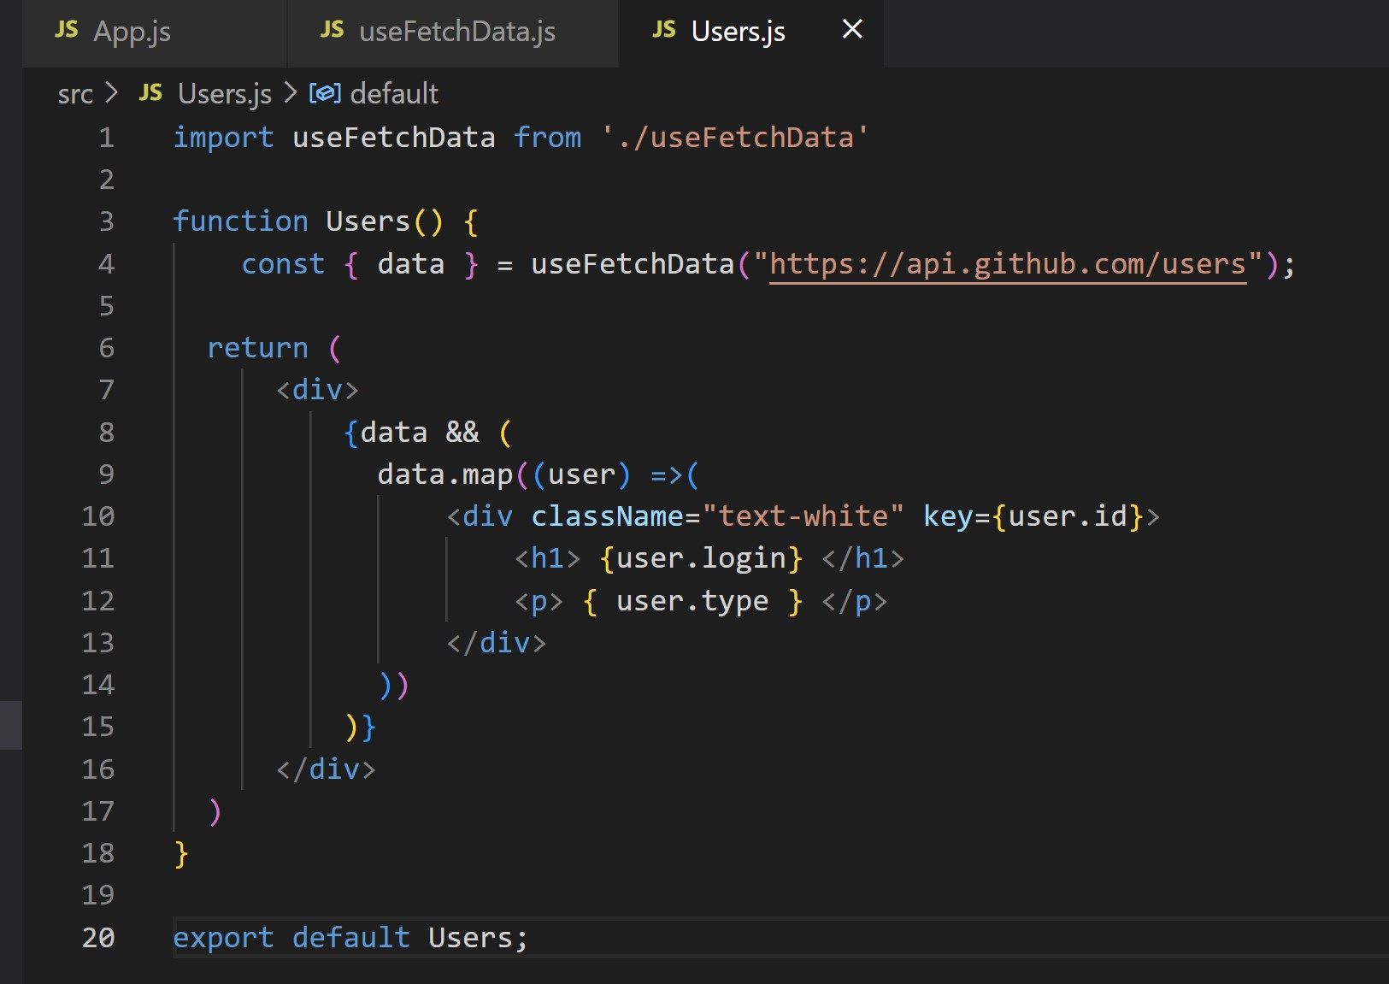
Create the new file, Users.js and add the code as shown here

Slide 17
We named the component Users.js because it will be used for fetching user data from the GitHub API.
We imported a custom hook: import useFetchData from ‘./useFetchData’.
We referenced the hook before the return statement and passed in the URL:
const { data} = useFetchData(“https://api.github.com/users”)
Using the && operator, the DOM will only get updated when the data variable has been updated with data from the API request that is, when data != null.
We looped through the data returned and output it to the DOM.

